Slide 1
Document Object Model (DOM)
Mendel Rosenblum

Slide 2
Browser JavaScript interface to HTML document
HTML document exposed as a collection of JavaScript objects and methods
The Document Object Model (DOM)
JavaScript can query or modify the HTML document
Accessible via the JavaScript global scope, aliases:
window
this (When not using 'use strict';)

Slide 3
DOM hierarchy
Rooted at window.document
Follows HTML document structure
window.document.head window.document.body
DOM objects have tons (~250) of properties, most private
Objects (representing elements, raw text, etc.) have a common set of properties and methods called a DOM "Node"

Slide 4
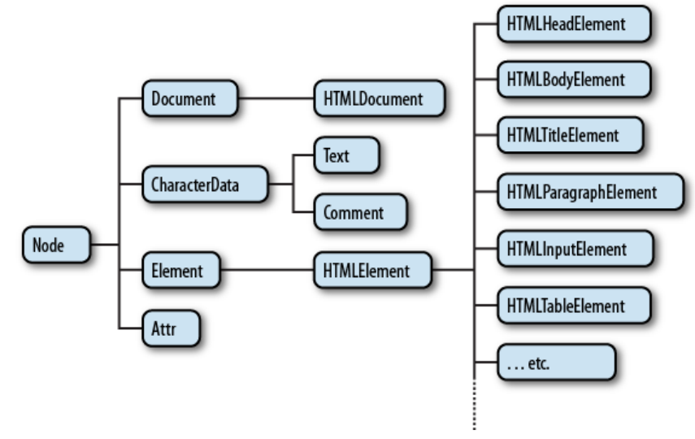
A partial class hierarchy of document nodes

Slide 5
DOM Node properties and methods
Identification
nodeName property is element type (uppercase: P, DIV, etc.) or #text
Encode document's hierarchical structure
parentNode, nextSibling, previousSibling, firstChild, lastChild
Provide accessor and mutator methods
E.g. getAttribute, setAttribute methods, etc..

Slide 6
<p>Sample <b>bold</b> display</p>
nodeName: P
nodeType: 1 (Element)
parentNode
parentNode
firstChild
lastChild
parentNode
previousSibing
previousSibing
nodeName: #text nodeType: 3 (Text) nodeValue: "Sample "
nodeName: B
nodeType: 1
nodeName: #text nodeType: 3 (Text) nodeValue: " display"
nextSibing
firstChild lastChild
nextSibing
parentNode
nodeName: #text nodeType: 3 (Text) nodeValue: "bold"

Slide 7
Accessing DOM Nodes
Walk DOM hierarchy (not recommended)
element = document.body.firstChild.nextSibling.firstChild;
element.setAttribute(…
Use DOM lookup method. An example using ids:
HTML: <div id="div42">...</div>
element = document.getElementById("div42"); element.setAttribute(…
Many: getElementsByClassName(), getElementsByTagName(), …
  Can start lookup at any element: document.body.firstChild.getElementsByTagName()

Slide 8
More commonly used Node properties/methods
textContent - text content of a node and its descendants
Previous slide example: P Node textContext is "Sample bold display"
innerHTML - HTML syntax describing the element's descendants.
Previous slide example: P Node innerHTML is "Sample <b>bold</b> display"
outerHTML - similar but includes element "<p>Sample <b>bold</b> display</p>"
getAttribute()/setAttribute() - Get or set the attribute of an element

Slide 9
Common DOM mutating operations
Change the content of an element
element.innerHTML = "This text is <i>important</i>";
Replaces content but retains attributes. DOM Node structure updated.
Change an <img tag src attribute (e.g. toggle appearance on click)
img.src="newImage.jpg";
Make element visible or invisible (e.g., for expandable sections, modals)
Invisible: Visible:
element.style.display = "none";
element.style.display = "";

Slide 10
DOM and CSS interactions
Can update an element's class
element.className = "active";
Can update element's style
element.style.color = "#ff0000"; // Not preferred way!
Can also query DOM by CSS selector
document.querySelector() and document.querySelectorAll()

Slide 11
Changing the Node structure
Create a new element (can also cloneNode() an existing one)
element = document.createElement("P");
or
element = document.createTextNode("My Text");
Add it to an existing one
parent.appendChild(element);
or
parent.insertBefore(element, sibling);
Can also remove an Nodes: node.removeChild(oldNode);
But, setting innerHTML can be simpler and more efficient.

Slide 12
More DOM operations
Redirect to a new page
window.location.href = "newPage.html";
Note: Can result in JavaScript script execution termination
Communicating with the user
console.log("Reached point A"); // Message to browser log
alert("Wow!"); confirm("OK?"); // Popup dialog

Slide 13
DOM's Coordinate System
The screen origin is at the upper left; y increases as you go down
The position of an element is determined by the upper-left outside corner of its margin
Read location with element.offsetLeft, element.offsetTop
Coordinates are relative to element.offsetParent, which is not necessarily the same as element.parentNode

Slide 14
DOM Coordinates
<div class="div1"><div class="div2"><div class="div3"></div></div>/</div>
X
Y
div1
offsetTop
div2
offsetLeft
offsetTop
offsetParent
offsetLeft
div3
offsetHeight
offsetParent
offsetWidth

Slide 15
Positioning elements
Normally elements are positioned automatically by the browser as part of the document
To pull an element out of the document flow and position it explicitly:
element.style.position = "absolute"; // anything but "static"
element.style.left = "40px";
element.style.top = "10px";
"absolute" - the element no longer occupies space in the document flow.
The origin inside an offsetParent (for positioning descendants) is just inside the upper-left corner of its border.

Slide 16
Positioning context
Each element has an offsetParent (some ancestor element).
When an element is positioned, coordinates such as element.style.left
are relative to its offsetParent.
Default offsetParent is the <body> element.
Some elements define a new positioning context:
  position CSS attribute is absolute (element is explicitly positioned)
  position CSS attribute is relative (element is positioned automatically by the browser in the usual way)
  This element will become the offsetParent for all its descendents (unless overridden by another positioning context)

Slide 17







Positioning Children
Parent margin
Parent border
top/offsetTop
Parent padding
left/offsetLeft
Child margin Child border

Slide 18
Element dimensions
Reading dimensions: element.offsetWidth and element.offsetHeight
Include contents, padding, border, but not margin
Updating dimensions: element.style.width and element.style.height

Slide 19
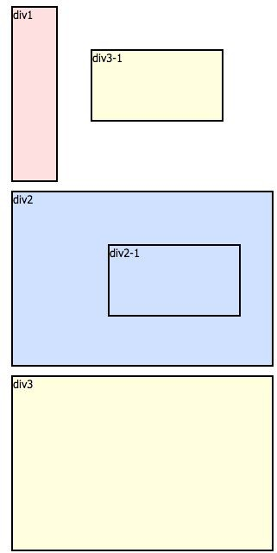
Positioning
<body>
<div id="div1">
<p>div1</p>
</div>
#div1 {
width: 50px; height: 200px;
background: #ffe0e0;
}
CS142 Lecture Notes - DOM

Slide 20
Positioning
…
<div id="div2">
<p>div2</p>
<div id="div2-1">
<p>div2-1</p>
</div>
</div>
#div2 {width: 300px; height: 200px; position: relative;
background: #d0e0ff;}
#div2-1 {width: 150px; height: 80px; position: absolute;
top: 50px; left: 100px; background: #d0e0ff;}
CS142 Lecture Notes - DOM
Notes:
position: absolute; is positioned relative to the nearest positioned ancestor (instead of positioned relative to the viewport, like fixed).

Slide 21
Positioning
...
<div id="div3">
<p>div3</p>
<div id="div3-1">
<p>div3-1</p>
</div>
</div>
#div3 {width: 300px; height: 200px; background: #ffffe0;}
#div3-1 {width: 150px; height: 80px; position: absolute; top: 50px; left: 100px; background: #ffffe0;}
CS142 Lecture Notes - DOM
Notes:
div21.offsetParent → div2
div31.offsetParent → body
Why? → div3 is not defined as positioned context, so body element will be offsetParent of the div31
no position property for div3

